Slide 1
LGBoostAlgorithm

Slide 2
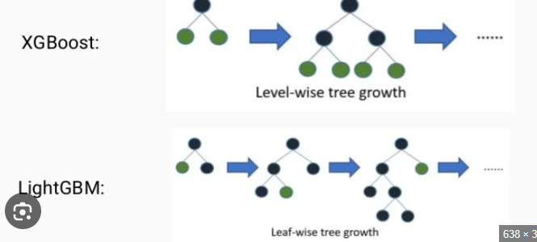
LGBoostRegressor

Slide 3
What is LGBoost regressor ?
LG Boost Regressor, more commonly referred to as LightGBM Regressor, is a high-performance, open-source gradient boosting framework developed by Microsoft. It is specifically designed to be faster, more efficient, and more scalable than traditional gradient boosting methods (like XGBoost) when working with massive datasets and high-dimensional features.

Slide 4
Parameters:
Objective: 'regression' (default for LGBMRegressor), 'mse' (mean squared error), 'mae' (mean absolute error), 'huber', or 'quantile
learning_rate: Shrinks the contribution of each tree by a small factor (default is 0.1). This helps prevent overfitting and is crucial for model robustness.
num_leaves: The maximum number of leaves in a tree (default is 31). This is the primary parameter to control tree complexity in LightGBM, as it uses a leaf-wise growth strategy.
max_depth: The maximum depth of the individual trees (default is -1, meaning no limit). If set to a positive value, num_leaves should be adjusted to be less than or equal to 2^max_depth.
boosting_type: Specifies the type of boosting to use. Options include 'gbdt' (Gradient Boosting Decision Tree, default), 'dart' (Dropout meets Multiple Additive Regression Trees), and 'rf' (Random Forest).
subsample (bagging_fraction in native API) and colsample_bytree (feature_fraction in native API): These control stochastic gradient boosting by using only a fraction of the samples (rows) and features (columns) for each tree, which helps reduce variance and prevent overfitting.
reg_alpha (L1 regularization) and reg_lambda (L2 regularization): Regularization terms that can be used to control model complexity and prevent overfitting.
min_child_samples (min_data_in_leaf in native API): The minimum number of samples (data points) required in a leaf node.

Slide 5
Code:
from lightgbm import LGBMRegressor
Regressor =LGBMRegressor(objective='regression', n_estimators=100)
regressor.fit(x_train, y_train)

